Slide 1
Requirement Engineering

Slide 2
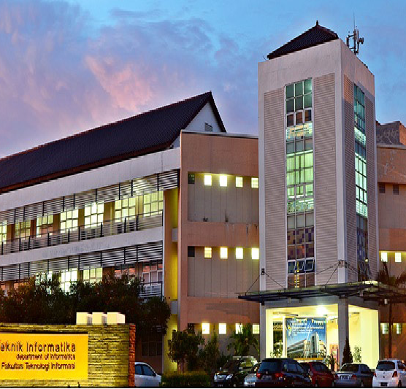
The Chaos Report
Requirement Engineering
Requirement Engineering Lecturer’s Team

Slide 3
Factors contributed to the success of the Project?
The Standish Group Report, ‘01 – The “Chaos” Report
yearly since 1994, survey of close to 300.000 projects
The CHAOS 10
Project Success Factors
1. Executive Management Support
2. User Involvement
3. Experienced project Manager
4. Clear Business Objectives
5. Minimized Scope
6. Standard Software Infrastructure
7. Firm Basic Requirements
8. Formal Methodology
9. Reliable Estimates
10. Other

Slide 4
Factors contributed to the failure of the Project?
The CHAOS 10
Project Challenged Factors
1. Lack of User Input
2. Incomplete Requirements & Specifications
3. Changing Requirements & Specifications
4. Lack of Executive Support
5. Technology Incompetence
6. Lack of Resources
7. Unrealistic Expectations
8. Unclear Objectives
9. Unrealistic Time Frames
10.New Technology
The CHAOS 10
Project Impaired Factors
1. Incomplete Requirements
2. Lack of User Involvement
3. Lack of Resources
4. Unrealistic Expectations
5. Lack of Executive Support
6. Changing Requirements & Specs
7. Lack of Planning
8. Didn’t need it Any Longer
9. Lack of IT Management
10. Technology Illiteracy

Slide 5

10 RE Traps

Slide 6
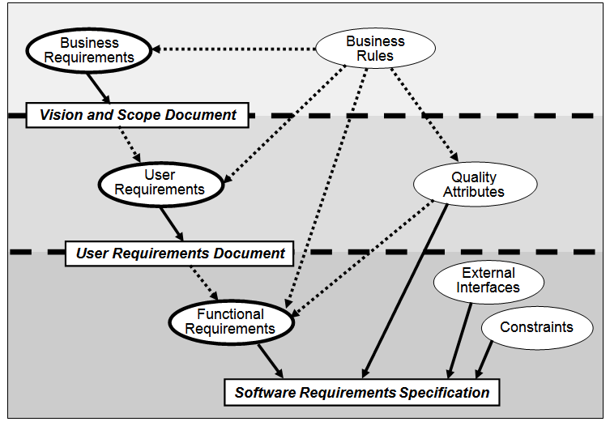
1. Confused about what is meant by “Requirement"
Cause: stakeholders have different view about requirement.
Solution:
Aware of the existence of levels of requirements.
Provide education about software requirements engineering to the stakeholder.

Slide 7
2. Inadequate Customer Involvement
Cause:
Customers are reluctant to get involved.
Developers rely too much on the 'superuser'.
Solution:
Build collaborative relationship with customer.
Identify the group of users and its requirements.

Slide 8
3. Vague, Ambiguous, and Incomplete Requirements
Cause: the use of natural language for requirement explanation
Solution:
State specific and measurable requirements.
Make sure the requirements can be achieved and realized
Prototype can make requirement more tangible

Slide 9
4. Unprioritized Requirements
Cause:
Customers consider all their requirements important.
Developers tend to underestimate requirements and ignore limited resource capabilities
Solution:
Functional requirements derived from use case descriptions will be more easily recognized and prioritized.
Using the level of priority scale (generally 3).
Assessing priorities based on the projected value of users and developers, regarding: estimated costs, technical risks, etc.

Slide 10
5. Building Unused Functionality
Cause:
Users: cannot distinguish between requirements and desire.
Developers: assuming too much, polishing SW with 'wow' features
Solution:
Trace back requirements to its origin
Avoid high cost but low value functionality

Slide 11
6. Analysis Paralysis
Cause:
Designers and programmers don't want to work on incomplete specifications.In fact, new requirements specifications are complete in the middle or towards the end of the project
Solution:
Software development process is carried out iteratively by setting milestones

Slide 12
7. Scope Creep
Cause:
Requirements changed/added but no additional resources
Solution:
Developers and consumers must place SW requirements specification documents as a contractual agreement between the two parties.
Considering the risk of changing requirements by providing slack time or reserve resources.

Slide 13
8. Inadequate Change Process
Cause:
New requirements requests are sometimes submitted informally by users to programmers.
The reason for the change was not documented.
Solution:
Follow change control procedures
Use issue-tracking tool to collect, track, and communicate changes

Slide 14
9. Insufficient Change Impact Analysis
Cause:
BAs, developers, or project managers sometimes agree to make suggested changes without carefully thinking through the implications (schedule, financial, conflicts)
Solution:
Understand the implications of accepting the change, identify the associated work to do, and estimate the effort and schedule impact

Slide 15
10. Solutions Presented As Requirements
Cause:
Users often present screen sketches as being their requirements, and elicitation discussions focus on user interface designs, not the underlying needs
Solution:
The BA should lead discussions to elicit user requirements
When BA hear a solution idea, ask questions to understand the real need behind each proposed solution

Slide 16

Requirements

Slide 17
Requirement Definition
The description of how the system should behave.
System properties or attributes, characteristics, and quality of the system so that it can provide value or be useful to its users.
Requirement Specification:
A set of documented requirements of a particular product or service that must exist or be performed or made.

Slide 18
What is Requirement? (What, why, how)
“.... The definition of requirements is a careful assessment of the requirements that must be met by the system.
Requirements must explain why a system is needed, based on current and future conditions, for example including internal operations and external markets.
Requirements must describe what system features will be able to serve and meet the context of the requirements.
And must explain how the system will be built...”
Ross, D. T., & Schoman, K. E. (1977). Structured analysis for requirements definition. IEEE transactions on Software Engineering, (1), 6-15.

Slide 19
What is Requirement? (What, why, how)
Enterprise Requirements (WHY)
for “context analysis” – the reason why the system was created. (e.g.: what is the use of an Academic IS in the campus management process)
Functional Requirements (WHAT)
a description of what the system does; What information needs to be managed?
requirements that need to be processed
Non-Functional Requirements (HOW)
(global) constraints on how the system will be built and function.
e.g.: ... –ilities and –ities → reliability, reusability, etc

Slide 20
What is ...
Functional Requirement
Example …

Slide 21
Functional Requirement
Describes the services, features, or functions provided or provided by the system for its users.
Representation of goals from users when they want to use the system.

Slide 22
What is ...
Non Functional Requirement
Example …

Slide 23
Non Functional Requirement
Describes a set of constraints, characteristics, and properties to the system, both in development and operational environments.
Quality attributes that must be met by the system.
Several functions/services that appear later are often the actualization of non-functional requirements at the implementation stage.

Slide 24
Non Functional Requirement(IEEE definition)
Non functional requirement – in system engineering, a software requirement describing not what the SW can do, but how SW will do it, example: - Performance – SW interface – Design limitation – SW quality attributes.
Non functional requirement is hard to test; so the evaluation is subjective.
Non functional requirement – generally stated informally, difficult to implement during the PL development process and need to be evaluated before delivery to consumers.

Slide 25
NFR Approach
Product oriented
Focus on system quality
Process oriented
Focuses on how NFR can be used in the design process
The goal is that quality can be measured when the system is complete
The goal is to make the right design decisions

Slide 26
NFR Approach(2)
Quantitative
Qualitative
Get metrics to measure quality Measures how well the design meets quality targets
Study the relationship between quality objectives Looking for reasons for exchange of goals etc

Slide 27
How to measure NFR?
Time
Transactions / sec
Response time
Time to complete an operation
Space
Main memory
Auxiliary memory
(Cache)
Usability
Training time
Number of choices
Mouse clicks
Reliability
Mean time to failure
Downtime probability
Failure rate
Availability
Robustness
Time to recovery
% of incidents leading to catastrophic failures
Data corruption probability after a failure
Portability
% of non-portable code
Number of systems where software can run

Slide 28
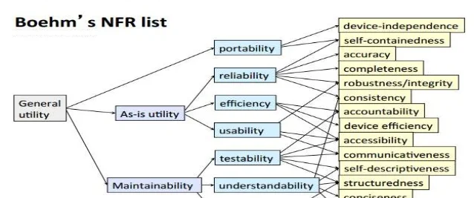

Slide 29
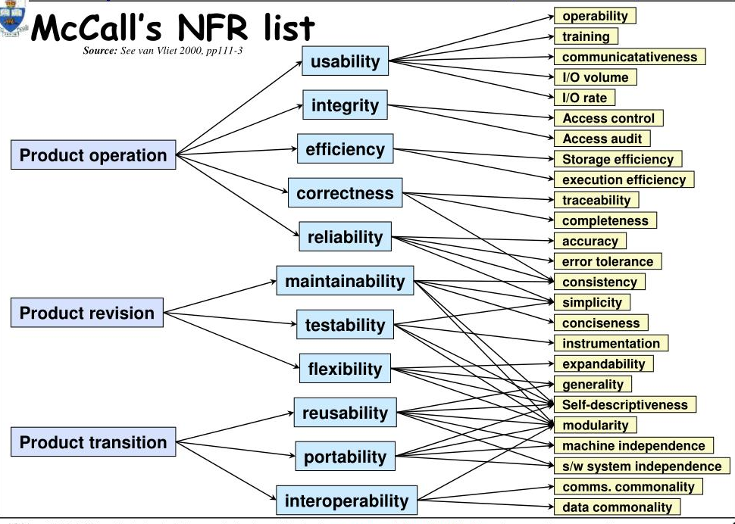

Slide 30
Discussion: Case study ATM (Automated Teller Machine)
List its functional requirements
List its non-functional requirements
State the metrics to measure non-functional requirements

